Slide 1

Site to site Vpn between Company Branches
DEPI |2024

Slide 2

Project Overview
Objective:
Design a secure, scalable, and segmented network to support 30 employees.
Provide secure access to critical resources (servers, printers, internet), and isolate guest traffic.
Enable secure remote access for employees, with protection from cyber threats.

Slide 3
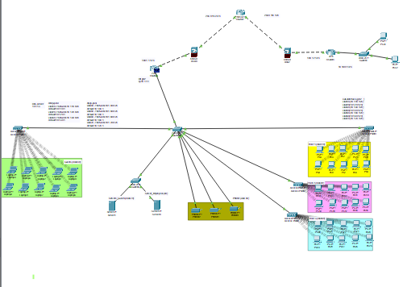
Network Topology Design
Router: Centralized routing for internal/external traffic.
Switches: Connecting workstations, printers, and servers.
Firewall: Enforcing security policies and managing inbound/outbound traffic.
Access Points (Wi-Fi): Segmented guest and employee Wi-Fi.

Slide 4
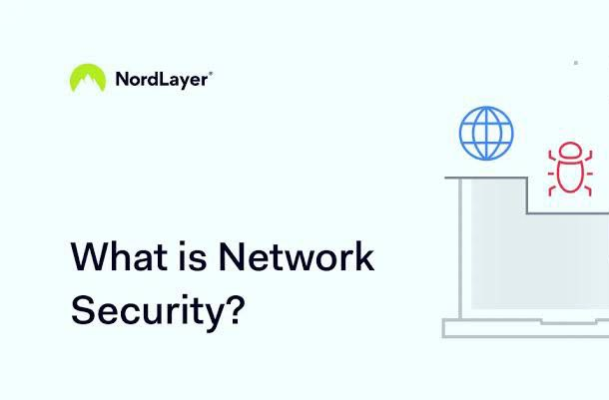
Security Measures Overview

Slide 5

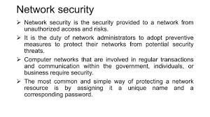
Security Measures Overview
DEPI |2024

Slide 6
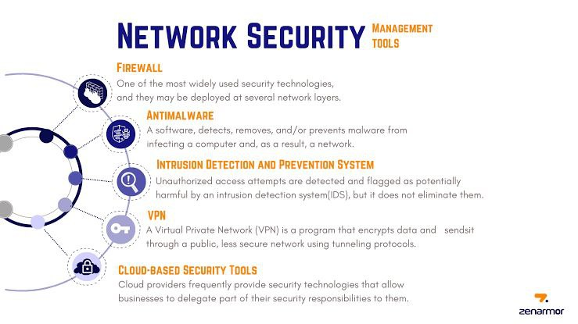

Slide 7
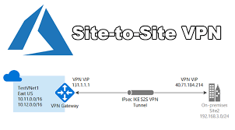
Secure Remote Access
DEPI |202

Slide 8
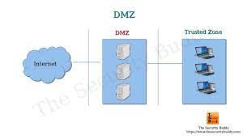
Access Control Lists (ACLs)
VLAN Access Restrictions: Guest VLAN restricted to internet only; Employee VLAN can access resources on Server VLAN.

Slide 9
Summary
The designed network provides robust security via segmentation, a strong firewall configuration, and secure remote access.
Regular monitoring and vulnerability assessments ensure that the network remains secure against evolving threats.

Slide 10

DEPI |2024
Thank You & Questions:

